Slide 1
Emotionalization of Data
Arnas Švenčionis
Mindaugas Drapanauskas
Edvinas Klevinskas

Slide 2
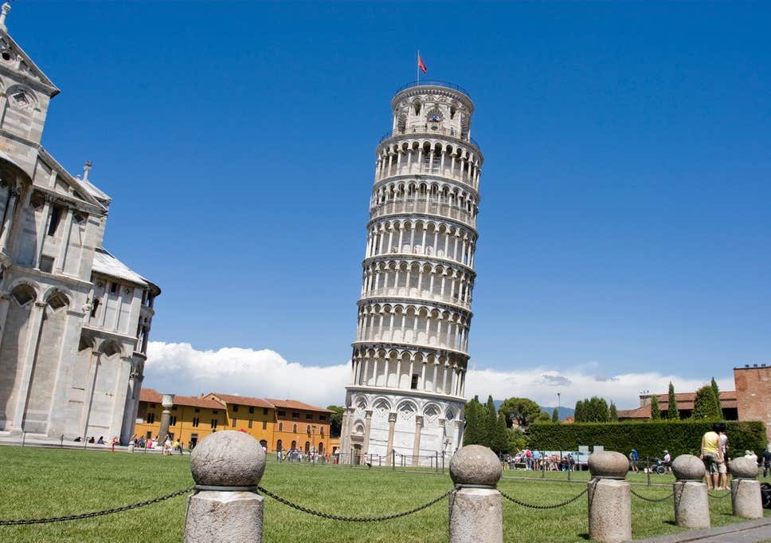
1. The distance our fingers travel while writing a 500 word essay
The average person keeps his fingers 1cm above the keyboard.
When typing a 500 word essay, with each keypress the person has to lower the finger by one centimeter and then raise it back up. So that’s 2 cm with each key press.
The average word length is 4.7 characters, that’s 2350 key presses.
Since there are 500 words, let’s say there’s 500 spaces (We won’t include punctuation).
So the person will have to press the keyboard 2850 times.
So now we multiply the keypresses with the distance a finger has to travel and get 5700 centimeters. That’s 57 meters.
To put that into perspective, the leaning tower of Pisa is 57 meters tall.

Slide 3
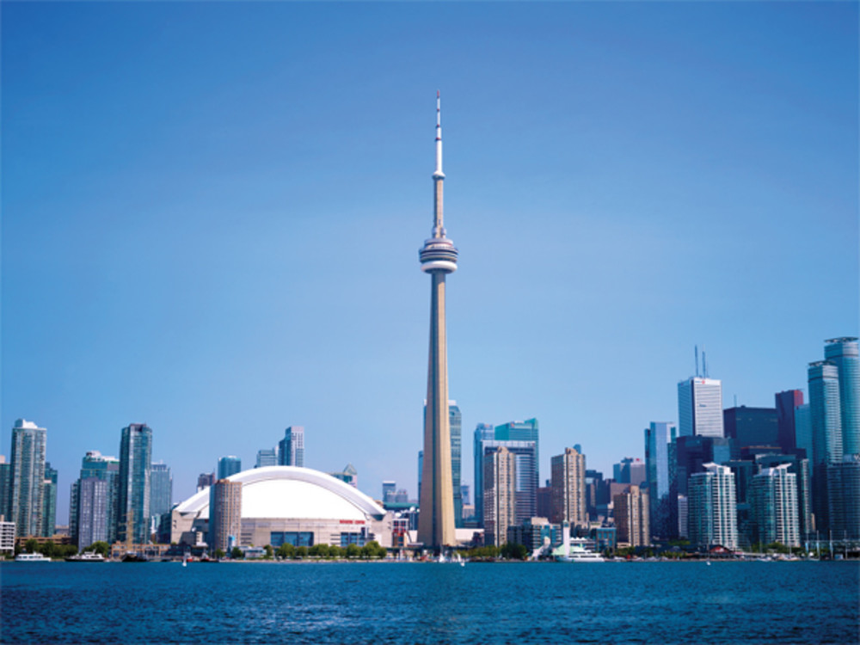
2. Amount of pixels in various resolution screens
The average pixel equivalent to roughly 1⁄96 inch (0.26 mm).
If we take a screen resolution such as 1920×1080 and calculate the amount of pixels in that screen, we get 2,073,600 pixels.
If we would put all the pixels in one line, the line would be 539 meters long.
In comparison, the CN tower in Toronto is 553 meters tall.

Slide 4
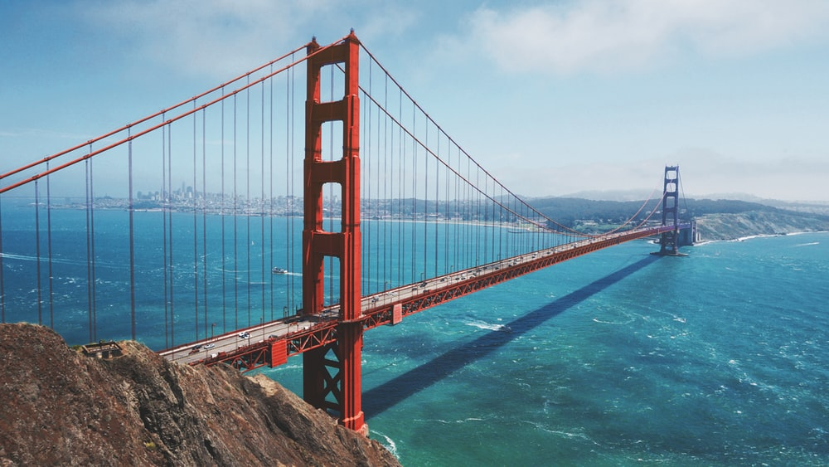
Here’s the same calculations but with different screen resolutions:
1280×720 screen is 921,600 pixels. That’s 240 meters. To put that into perspective, the Golden state bridge is 240 meters tall as well.

Slide 5
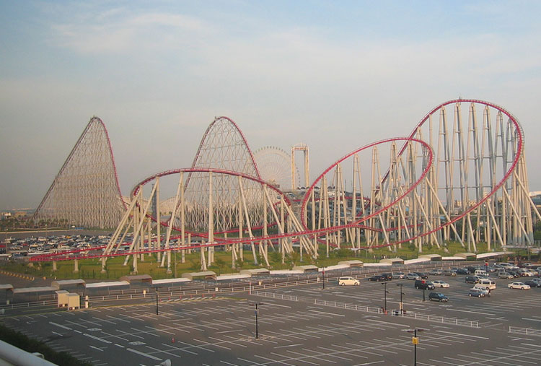
3840×2160 (4K) screen is 8,294,400 pixels. That’s 2156 meters. It’s about as long as the longest rollercoaster ride in the world - steel dragon 2000.

Slide 6
3. Age of the internet
The Internet is 11141 days old today (https://howoldistheinter.net/)
About 353,000 babies born each day.
That’s about 3,932,773,000 people born since the internet was created
The world population is about 7.7 billion.
So the internet is older than over half of the world’s population.

